Slide 1
Drive to Breathe in (COVID) ARDS
Brian Locke, MD
PGR, Feb 10 2022

Slide 2
Case: 66M with COVID-ARDS
Day 14 of symptoms, 7 of hospitalization, 5 of intubation
On ACVC+ (aka PRVC), 70% FiO2 (improving from 100%), 10 PEEP, RR 18 (set) 24 (delivered)
Sedation: Fentanyl 125 mcg/hr gtt; Propofol 35 mcg/hr. Was on Nimbex last 2 nights and was proned. Now trying to lighten sedation.
On exam: accessory muscle use, RASS: -4 (Deep Sedation)
The ventilator waveforms suggested work shifting to the patient
Next Step?
Notes:
PRVC: adaptive targeting – pressure control where

Slide 3
Roadmap
Drive to Breathe & Dyspnea
Model to understand chemoreflex, air hunger, and ventilatory support
*Epistemological Field Trip: ARDS trials
Methods of approximating drive to breathe
Relationship of drive to breathe and sedation
------
Next time: assessing air hunger; relationship to PICS

Slide 4
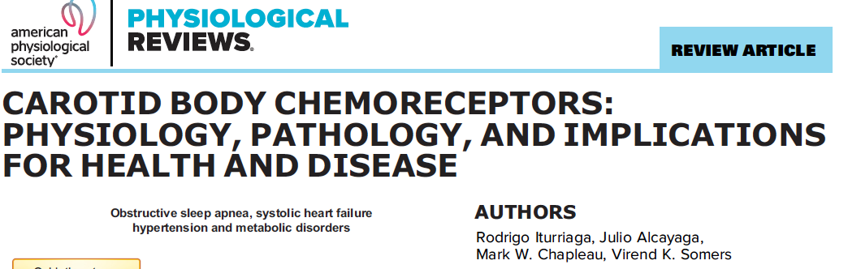
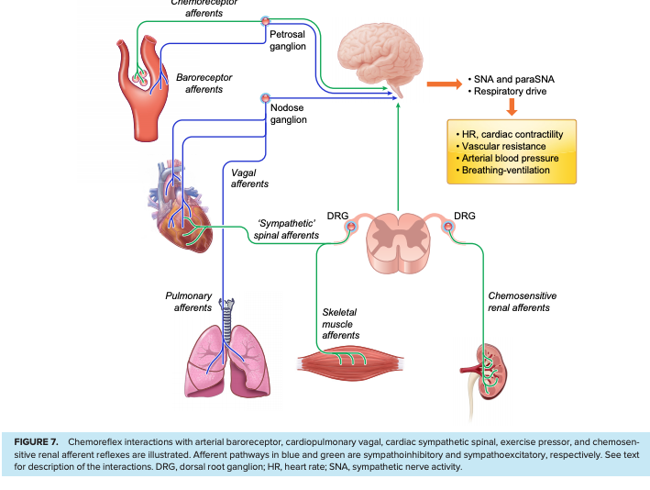
Respiratory Drive =
Intensity of output from the neural centers to the muscles of breathing
Does not always go along with tachypnea
In health: directly relates to electrical activity in motor neurons, diaphragm, and transdiaphragmatic pressure (or pressure developed by all inspiratory muscles, P_{mus})
Notes:
https://www.atsjournals.org/doi/pdf/10.1164/rccm.201903-0596SO - Key reference
https://journals-physiology-org.ezproxy.lib.utah.edu/doi/pdf/10.1152/physrev.00039.2019
“Breathlessness is a multidimensional symptom with a sensory and an affective component.”
Torture – survivors, asphyxia is the most correlated factor with subsequent PTSD, and the only one where cumulative exposure lead to more severe symptoms: https://erj.ersjournals.com/content/49/5/1602099
- Obvious evolutionary reasons why we would have an especially strong aversion to inability to breathe – death imminent

Slide 5
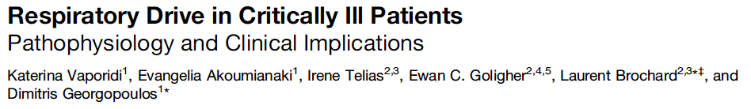
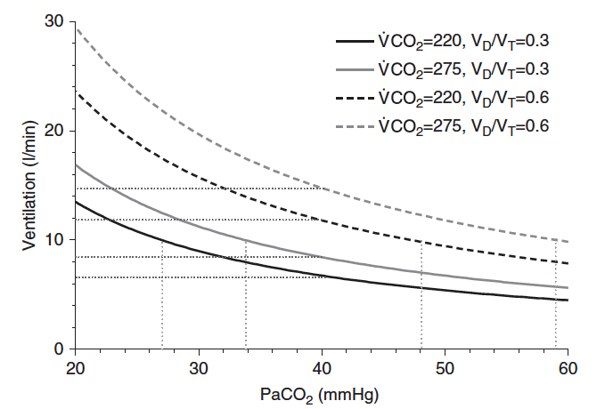
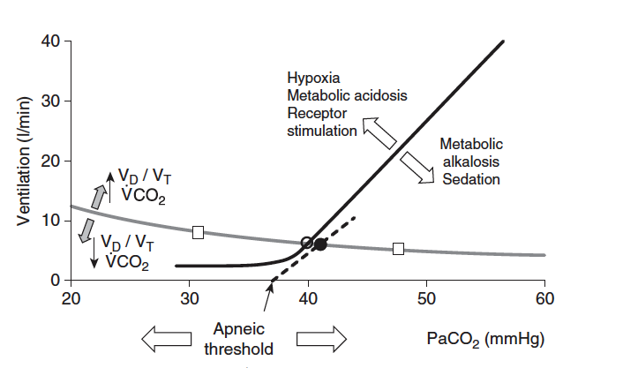
Chemoreflex (central and peripheral)
Cortical feedback (can override autonomic control – voluntary apnea)
Pain, anxiety. Also, wakefulness drive to breath
Cortical brain injury = hyperventilation, brain stem injury = hypoventilation.
Metabolic rate
Direct inputs, not really known how much this determines breathing rate independent of chemoreflex.
Explains why PaCO2 doesn’t initially increase at the start of exercise.
Notes:
Model to understand chemoreflex responses
The normal
respiratory pattern generator is in the brain stem and is affected by chemical
stimuli (especially pH and to a lesser extent Po2 and Pco2), mechanical inputs
from the lungs and thoracic cage (especially stretch receptors), and the cerebral
cortex (voluntary activity, anxiety, pain reflexes).
***
Brainstem somehow is able to calculate deadspace (no one is quite sure how – Whipp’s Law)

Slide 6

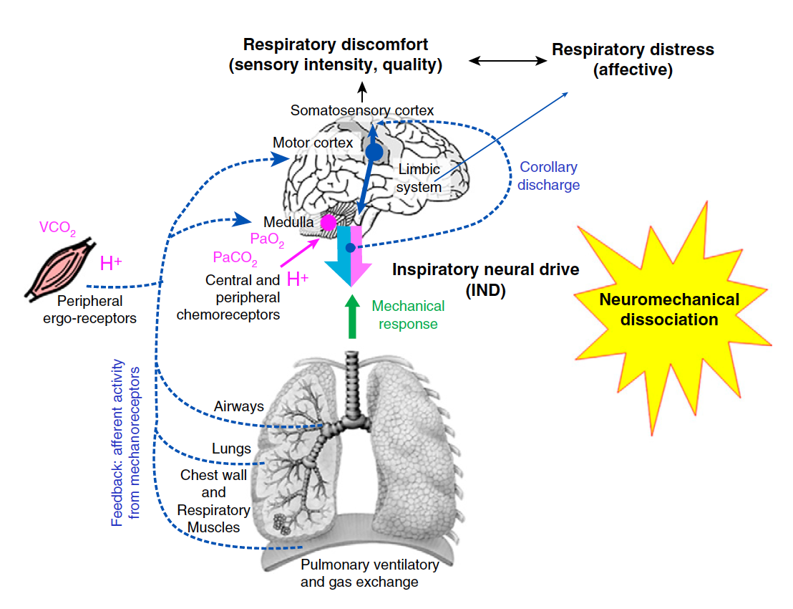
Dyspnea =
Sensation of breathing discomfort
Air Hunger: unsatisfied inspiration
Excessive respiratory effort
Tightness
NOT equivalent to high respiratory drive
2 components:
Physiologic
Affective (cognitive perception, symptom)
Notes:
The affective domain involves
the cognitive perception of the symptom
and its emotional elaboration (“distressed
breathing”)
[ ] Banzett RB, Pedersen SH, Schwartzstein RM, Lansing RW. The affective dimension of
laboratory dyspnea: air hunger is more unpleasant than work/effort. Am J Respir Crit Care
Med 2008;177:1384–1390.
[ ] Banzett RB, Lansing RW, Binks AP. Air Hunger: A Primal Sensation and a Primary
Element of Dyspnea. Compr Physiol 2021;11:1449–1483.

Slide 7
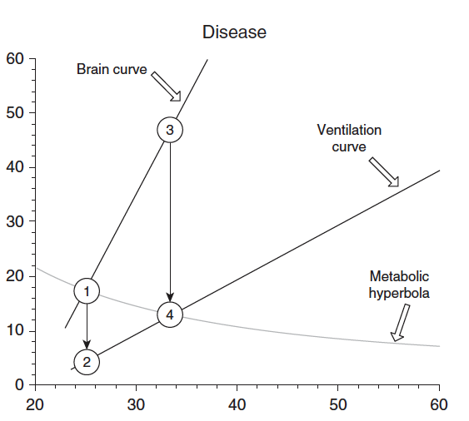
Neuromechanical Dissociation– Air Hunger?
Brain Curve: changes if flow-generation pathway were intact
Ventilation Curve: actual flow generation
Brain curve = Ventilation Curve in health
Dissociation between the neural output and the achieved ventilation: can’t breathe
Neuromuscular dysfunction (neuron/NMJ disease, respiratory muscle injury, disrupted length-tension relationship)
Loads on the respiratory system
Steady state occurs at the intersection of the ventilation curve (not brain curve) and the metabolic parabola.
High drive = vent curve – metabolic parabola intersection (4) is higher than the PaCO2 desired by the brain (1)
Ventilation curve can be on either side of the brain curve with mechanical ventilation
Notes:
Vertical = ventilation (l/min)
Horizontal = PaCo2 (mmHg)
Equation of Motion
R side of equation = constant elastance and resistance of the respiratory system and expiratory lung volume
Note: this is a model of how things work – it can make predictions that seem generally accurate – but assumptions based on it might be inaccurate at times when the model breaks down. We can’t directly measure the brain curve, for example. (we know the ventilation curve is correct, at least with transient elevations of CO2

Slide 8
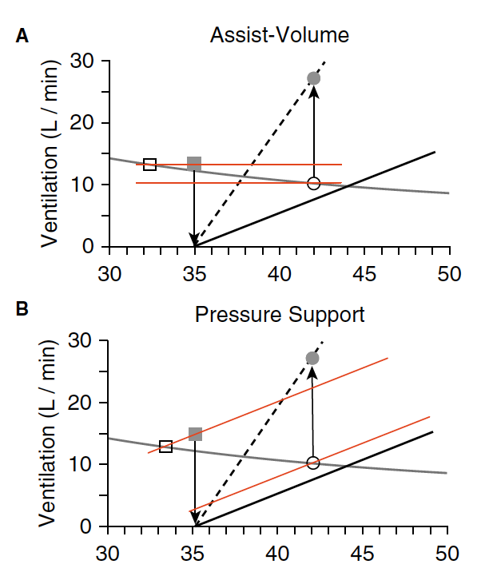
P_{mus} : Vt
P_{tot} = P_{mus} + P_{vent} = ( V̇*R )+ (𝚫V*ERS)
Spontaneous breathing:
greater Pmus → greater Vt
ACVC:
P_{mus} : Vt unrelated(ish) Vt targeted
P_{vent} is adjusted so that P_{tot} stays same
PS:
greater Pmus → greater Vt
parallel but upshifted ventilation line (due to constant pressure)
Notes:
Relationship between Pmus and Vt at constant elastance and resistance of the respiratory system and expiratory lung volume
Pmus – subatmospheric pressure generated by the respiratory muscles
3 reasons to intubate somewhat are: airway protection, refractory hypoxemia, or to move that curve.

Slide 9
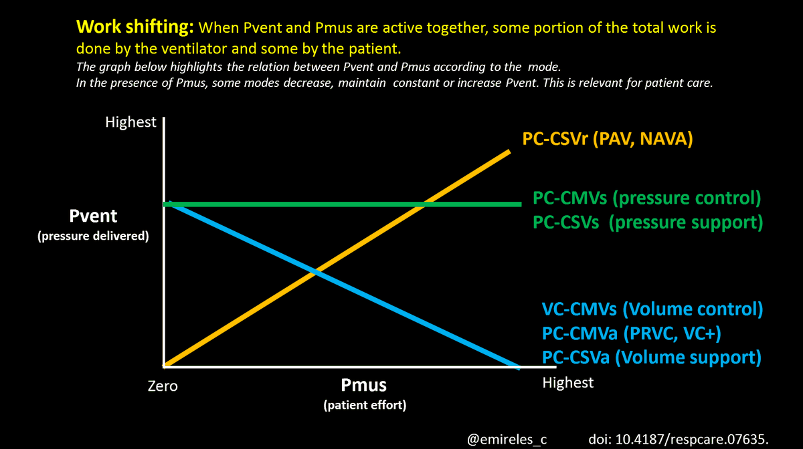
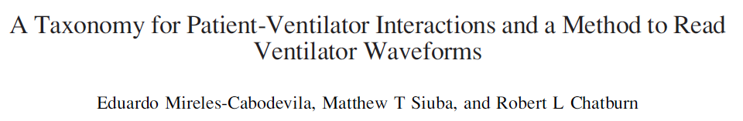
Notes:
Same idea. Different representation.

Slide 10
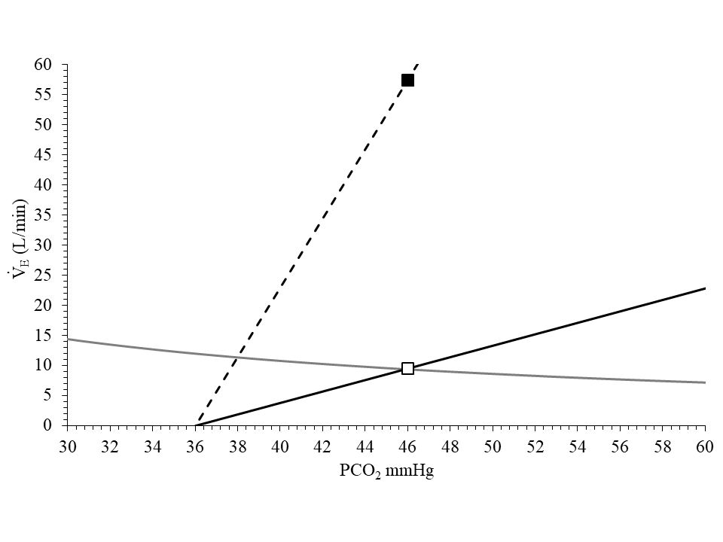
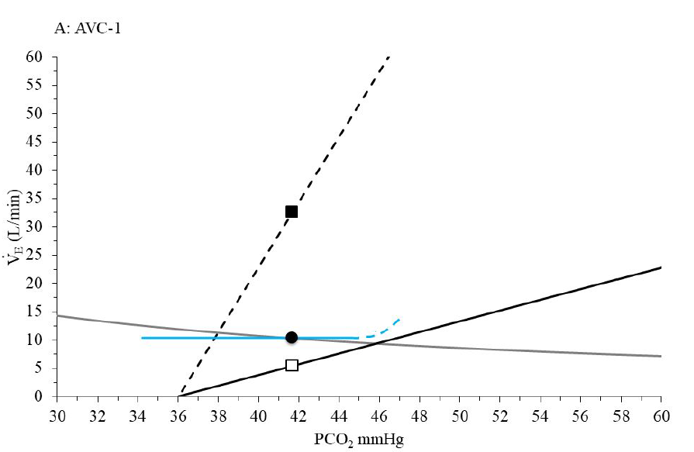
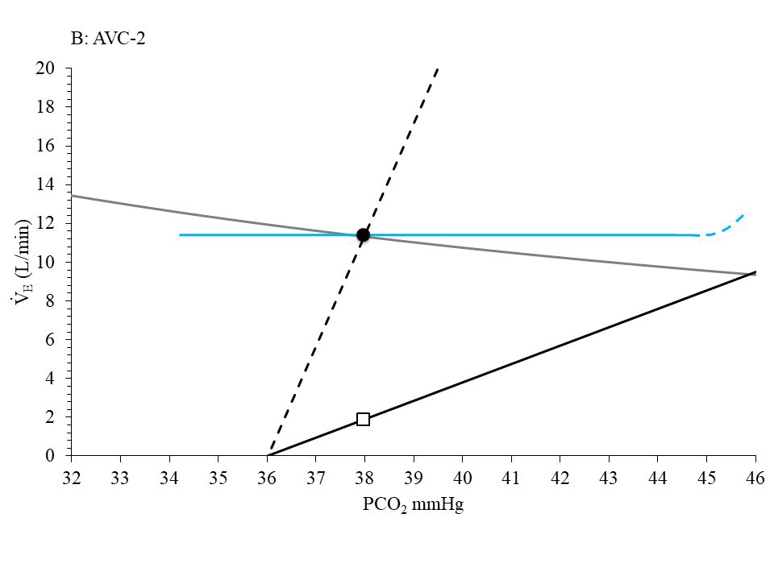
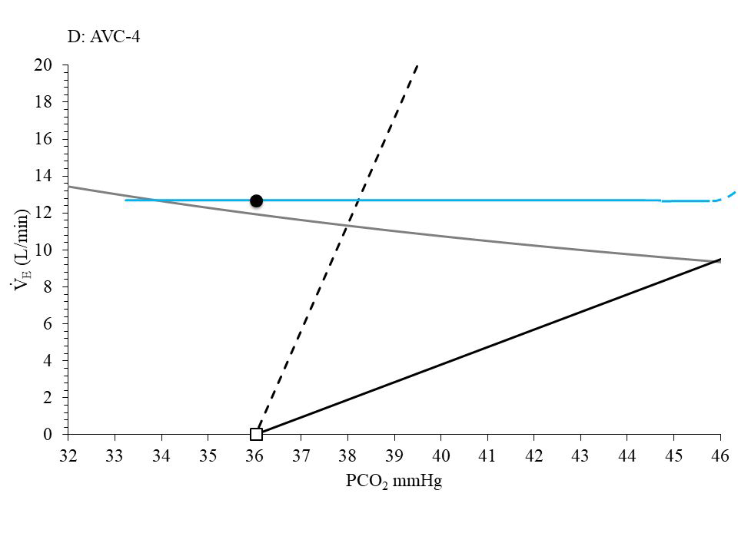
1. Unassisted breathing. Brain curve wants 55L due to dissociation of curves. ‘Can’t breathe’
2. Intubated, AC/VC, relieving some work of breathing.
Brain curve wants 35L/min (decreased dissoc. by 43%)
3. Intubated, AC/VC, increased settings so that Vent is
giving exactly what the brain wants.
(Decreased 80% from intubation)
4. Intubated, AC/VC – ventilating beyond what the patient needs. Will go apneic if taken off control mode.
Apneic threshold

Slide 11
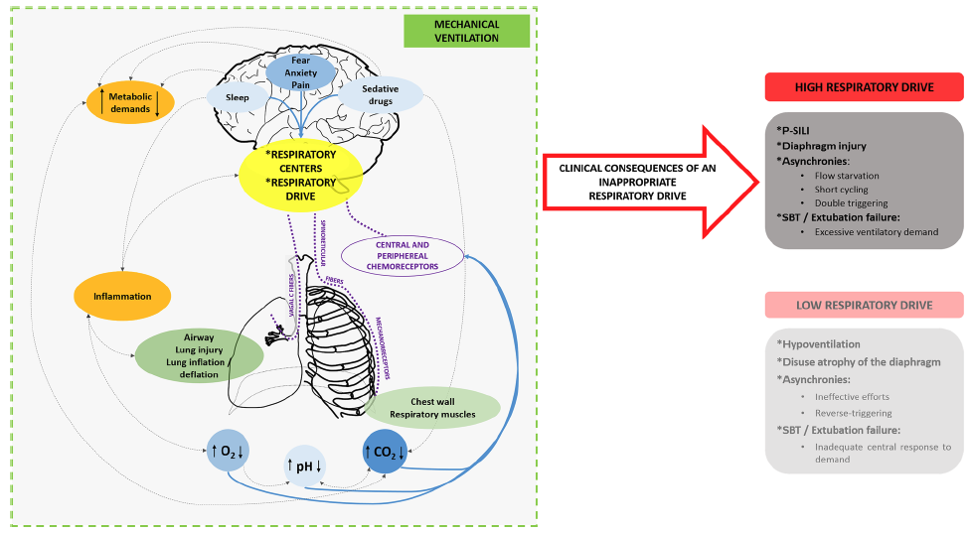

Why care about respiratory drive? 3 Goals of Vent Management
Safety | Comfort | Liberation
Breath-Stacking Work shifting P-SILI? | Ventilator / Flow Dis-synchrony Agitation Sleep Quality (Overventilated) | Diaphragmatic Myotrauma
Notes:
Image from: Intensive Care Med (2018) 44:1936–1939
https://doi.org/10.1007/s00134-018-5091-2
” in non-intubated
patients, excessive respiratory drive can overwhelm
lung-protective reflexes (e.g., Hering–Breuer reflex) that
aim to limit lung volume, leading to lung injury and
inflammation.
“
Ventilator Dys-synchrony: when vent settings can’t accommodate a patient’s respiratory drive, pharmacologic blunting is recommended [4]
We already do things to modulate this – primarily sedation
Wasted effort (-> increased O2 cost of breathing)
P-SILI? (5, 110, 111) – no direct evidence but pathophysiologic understanding suggests this is a problem.
Diaphragmatic myotrauma? -> longer ventilation
Sleep quality – (overventilation -> disrupted sleep)
High respiratory drive associated with agitation (76, 101, 107, 57, 100)
Association with Dyspnea***
(ie, adequate gas exchange with
avoidance of ventilator-induced lung injury), comfort (ie, optimum
patient-ventilator synchrony with adequate support
for the work of breathing), and liberation (ie, the shortest
possible duration of ventilation with avoidance of adverse
events).
Goals of IMV management
Safety (LTVV)
Comfort
Weaning->Extubation
Citation 4: Devlin JW, Skrobik Y, Gélinas C, et al: Clinical practice guidelines
for the prevention and management of pain, agitation/
sedation, delirium, immobility, and sleep disruption in adult
patients in the ICU. Crit Care Med 2018; 46:e825–e873
“This can produce severe agitation/
anxiety, muscle injury, regional lung overstretching injury (e.g., self induced
lung injury), and prolongation of the need for mechanical ventilatory
support
“
5. Brochard L. Ventilation-induced lung injury exists in spontaneously breathing patients with acute respiratory failure: yes. Intensive Care Med 2017;43:250–252
110. Yoshida T, Uchiyama A, Matsuura N, Mashimo T, Fujino Y.
Spontaneous breathing during lung-protective ventilation
in an experimental acute lung injury model: high
transpulmonary pressure associated with strong spontaneous
breathing effort may worsen lung injury. Crit Care Med 2012;40:
1578–1585.
111. Yoshida T, Uchiyama A, Matsuura N, Mashimo T, Fujino Y. The
comparison of spontaneous breathing and muscle paralysis in two
different severities of experimental lung injury. Crit Care Med 2013;
41:536–545.
76. Jubran A. Rapid shallow breathing: causes and consequences. In:
Mancebo J, Net A, Brochard L, editors. Mechanical ventilation and
weaning: update in intensive care medicine. Berlin, Germany:
Springer; 2003. pp. 161–168.
101. Parshall MB, Schwartzstein RM, Adams L, Banzett RB, Manning HL,
Bourbeau J, et al.; American Thoracic Society Committee on
Dyspnea. An official American Thoracic Society statement: update
on the mechanisms, assessment, and management of dyspnea.
Am J Respir Crit Care Med 2012;185:435–452
57. Mendonca CT, Schaeffer MR, Riley P, Jensen D. Physiological
mechanisms of dyspnea during exercise with external thoracic
restriction: role of increased neural respiratory drive. J Appl Physiol
(1985) 2014;116:570–581.
100. Faisal A, Alghamdi BJ, Ciavaglia CE, Elbehairy AF, Webb KA, Ora J,
et al. Common mechanisms of dyspnea in chronic interstitial and
obstructive lung disorders. Am J Respir Crit Care Med 2016;193:
299–309.
107. Jubran A, Tobin MJ. Pathophysiologic basis of acute
respiratory distress in patients who fail a trial of weaning from
mechanical ventilation. Am J Respir Crit Care Med 1997;155:
906–915.
Kyo meta-analysis - https://jintensivecare.biomedcentral.com/articles/10.1186/s40560-021-00565-5

Slide 12
Consequences: ↑drive to breathe and ↓ Vt
Double Trigger → Second Breath before 1st exhaled
Cause: the patient’s brain stem wants a larger/longer inspiration than the vent gives.
Low tidal volume is NOT the brainstem’s response to high drive to breath
Problem: Much more than 8 ml/kg IBW lung distention -> VILI
Notes:
[ ] retool this slide to fit the flow better. Ie. this is one consequence of higher drive to breath
Aka early cycling.
Flow cycle threshold could also be set too high.

Slide 13
Management: Breath Stacking
Treatment options: SCCM guidelines recommend:
Increase vent inspiratory time
increase tidal volume
Increase sedation*
Neuromuscular blockade if needed
Approach might differ depending on duration of ARDS
Notes:
Two breaths are given for the patient making one respiratory effort
This is a problem because it’s equivalent to 12 ml/Kg of distention in the lung.
[ ] combine

Slide 14
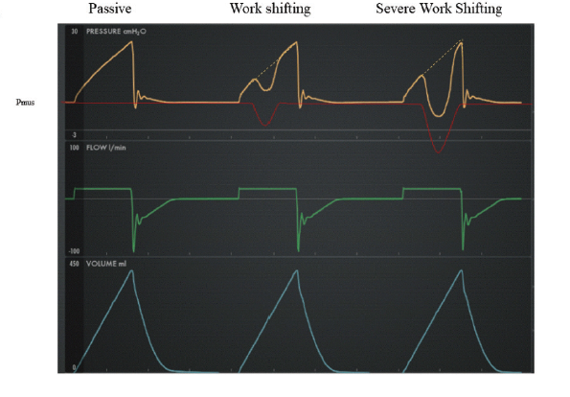
Work shifting: P_{total} = P_{vent} + P_{mus}
How much of the work of breathing is done by the ventilator? Depends on:
Drive to breath
Respiratory efficiency
Vent settings (flow starvation?)
In AC/VC: work shifting = deflection in the pressure curve
Severe if drops below the PEEP
In PC/VC: work shifting = deflection in the volume/flow curve
Notes:
Pmus . Pvent . (Ers V) . (Rrs V˙ ), where Pmus is
the muscle pressure generated by the patient’s inspiratory
effort, Pvent is the airway pressure relative to PEEP generated
by the ventilator, Ers is the elastance of the respiratory
system, V is the volume change relative to end-expiratory
lung volume, Rrs is the resistance of the respiratory system
and artificial airway, and V˙ is the flow (positive is inspiration,
negative is expiration).

Slide 15
Case: What about PRVC / ACVC+?
PRVC / ACVC+: Pressure Control with adaptive targeting
If Vt is exceeded, next breath delivered with lower P_{vent} → target the set VC
Good flow synchrony – RT’s like this (and it’s a good thing)
Work shifting? Two scenarios:
Respiratory mechanics are improving
less vent support -> move toward weaning
Resp mechanics bad, but drive to breath is high
Vt can be exceeded because we are ventilating with lower Vt than brainstem wants
Less vent support -> more work shifted to patient. Opposite of what we want
More of the work is shifted onto the patient
Ventilator pressures are lower, but transpulmonary pressure is not
Notes:
https://twitter.com/ArielG_RRT/status/1486485229477011458/photo/1

Slide 16
Vt is exceeded, two scenarios
VC+/PRVC: Neuromechanical dissociation
VC+/PRVC:
Improving
Notes:
This makes sense – as the ventilator is trying to adapt to the patient – patient wants to do MORE, but this is injurious to the lungs. We are trying to stop that
[ ] make sure the pressure controlled diagram looks similar.

Slide 17
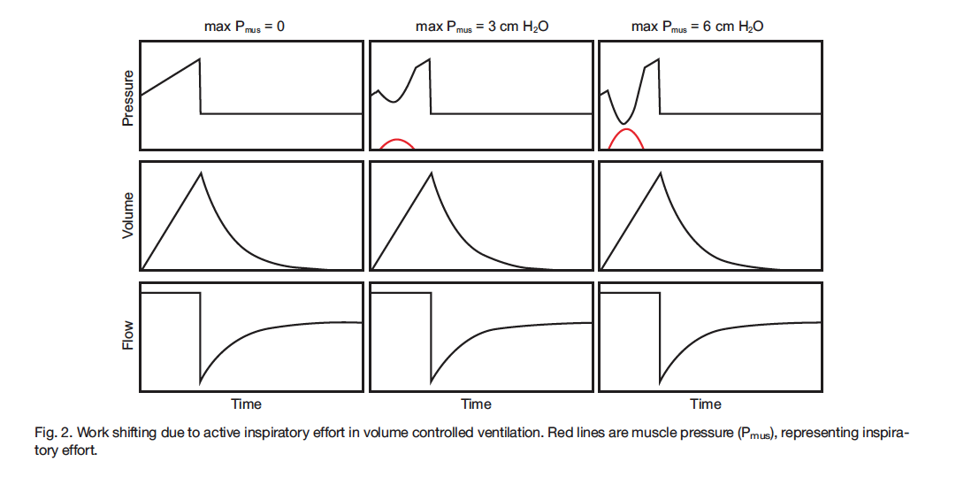
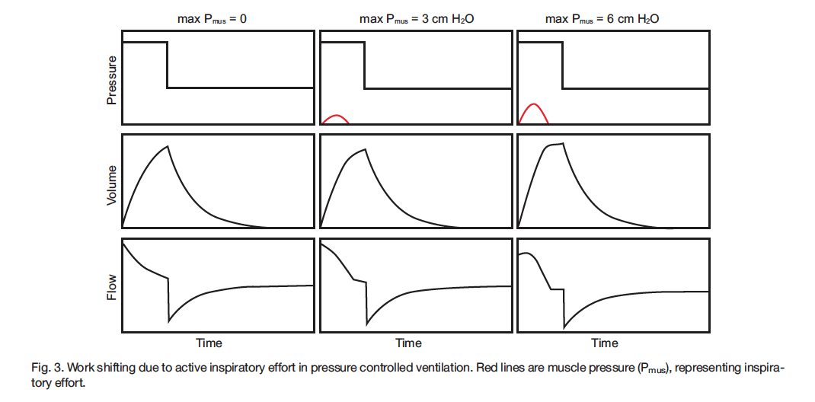
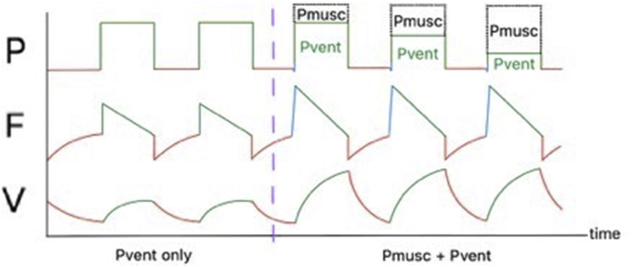

Notes:
Mayo nomenclature which is a bit funky
VC-CMV = ACVC
PC-CMVa = PRVC / ACVC+
PC-CMVs = ACPC
PC-CSVr = proportional assist/NAVA
Note: negative trial of NAVA - https://www.sciencedirect.com/science/article/pii/S0883944122002799

Slide 18
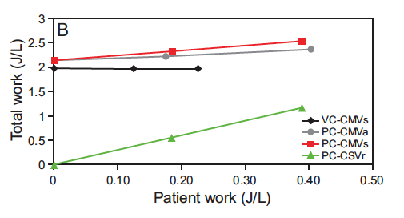
PRVC / ACVC+: simulation
VC-CMV = ACVC
PC-CMVa = PRVC / ACVC+
PC-CMVs = ACPC
PC-CSVr = proportional assist/NAVA
Notes:
Simulation trial: muscular effort assessed using esophageal probe the measure pMUS
=➔ as the patient does more work, the TOTAL work increases, which represents asynchrony.
Further right => more work shifted onto patient (can be a good think, or a bad thing)
I hear IMC is getting esophageal probes for another study- which if the info is going to be recorded on the ventilator flow sheet you could calculate a realtime estimate of work shifting and look to see if this effect does occur and if so, how often.
Method of detection:
“First, clinical detection was the most common
method reported (39% of studies), and this involved visual
inspection of pressure and flow waveforms displayed by
the ventilator. Second was the detection of adjunctive signals,
such as EAdi (used in 73% of the studies), esophageal
pressure (used in 15% of the studies), and transdiaphragmatic
pressure (12% of the studies). The third category was
the detection by automated algorithms, as proposed by 8%
of the studies; such methods included analysis of the expiratory
flow waveform to detect ineffective inspiratory
efforts.
“
Review article Haro: Haro et al22

Slide 19
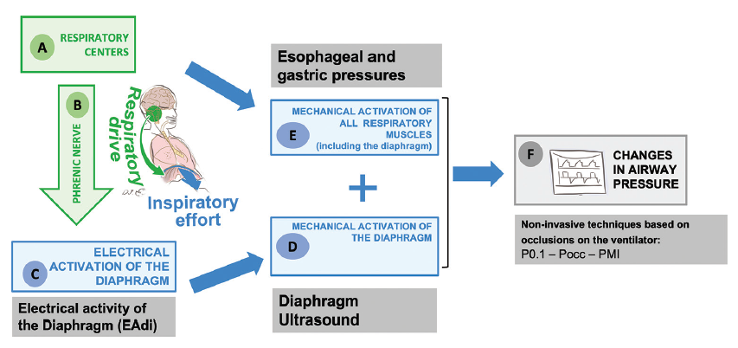
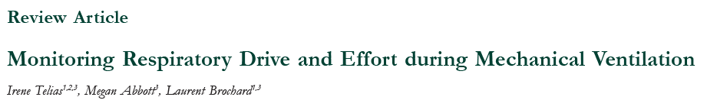
Assessment of respiratory drive
Can’t directly measure:
All the following are measures of ventilatory output. Thus, they will be inaccurate of there is some problem between
P0.1 – change in pressure against an occluded airway
Diaphragm Motor output: EAdi
Diaphragm US
Pmus during inspiration
Notes:
Figure from Monitoring respiratory effort - J Translat Crit Care Med 2021;3:13

Slide 20
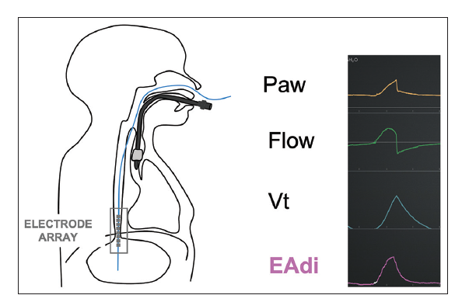
Eadi – Diaphragm motor output
Surface electrodes or esophageal catheter
Closest to the brain in the pathway
Validated in:
Healthy volunteers – correlates directly with Ve
ECCO2R – Eadi decreases in proportion to CO2 removal
No (known) normal values – only tells trends
Specific to diaphragm, not recruitment of other muscules.
Notes:
Electromyography is a more technically challenging
technique for monitoring respiratory muscle activity but
measurement of EAdi is now available by using one type
of ventilator (
Maquet®, SERVO-i or SERVO-u). EAdi
signals are acquired by placing a specialized nasogastric
catheter fitted with electrodes. These signals can be
employed to estimate respiratory drive and inspiratory
effort. The signal amplitude range can vary considerably
between individuals and it is difficult to establish the reference
range

Slide 21
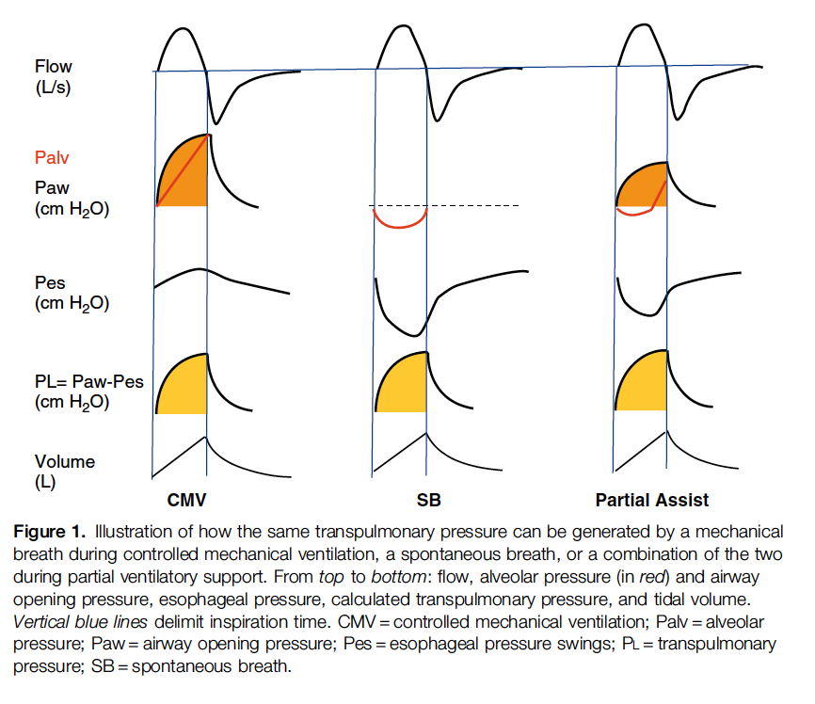
P_{di} (transdiaphragm: Eso – Gastric) & P_{mus} (all resp)
dPdi / dt = rate of pressure – quantifies respiratory drive as long as the pathway is intact
5 cm H2O / second = normal in a healthy person
Elevated = must have high drive
Low = either low drive, or neuromuscular/diaphragm dysfunction
Healthy Pmax = 100 cmH2O (pleural pressure ~100cmH2O below atm)
In health – can sustain 50-60% of max pressure indefinitely (higher leads to fatigue).
Presumably lower threshold in illness
Transpulmonary pressures quite high -> P-SILI?
Notes:
Diaphragm thickness as a surrogate? Doesn’t work - https://openres.ersjournals.com/content/6/suppl_4/14
Figure from DOI: 10.1164/rccm.201605-1081CP
Thickening fraction - diaphragm
TFDi TFdi is approximately 20 ± 15%

Slide 22
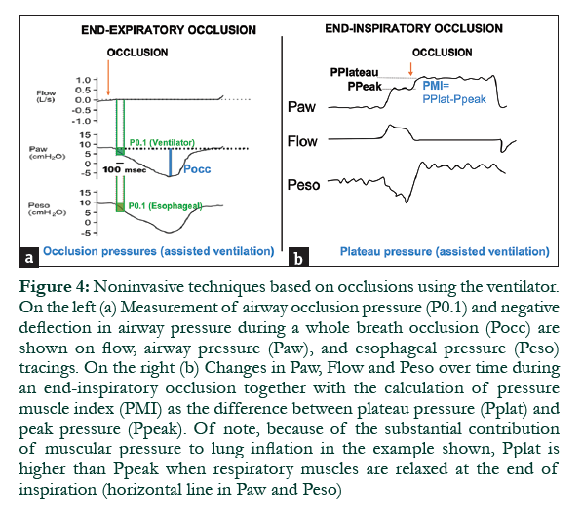
P0.1: Airway occlusion pressure
Drop in airway pressure Paw in 100 ms of inspiratory effort against an occluded airway.
Normal P0.1 = 0.5-1.5 cmH2O
Above 3.5 in IMV = high drive (validated against esophageal pressure probes)
May underestimate drive in neuromuscular dysfunction, intrinsic peep, flow problems
Significant breath to breath variation -> average 3-4 measurements.
Can do on Puritan Bennett 980
Notes:
“P0.1 is independent
of respiratory mechanics and the patient’s reaction and
is, importantly, unaffected by respiratory muscle weakness.
Breath-to-breath variability of P0.1 is considerable
but the average of 3–4 values represents a reliable index
of the patient’s drive.
“

Slide 23
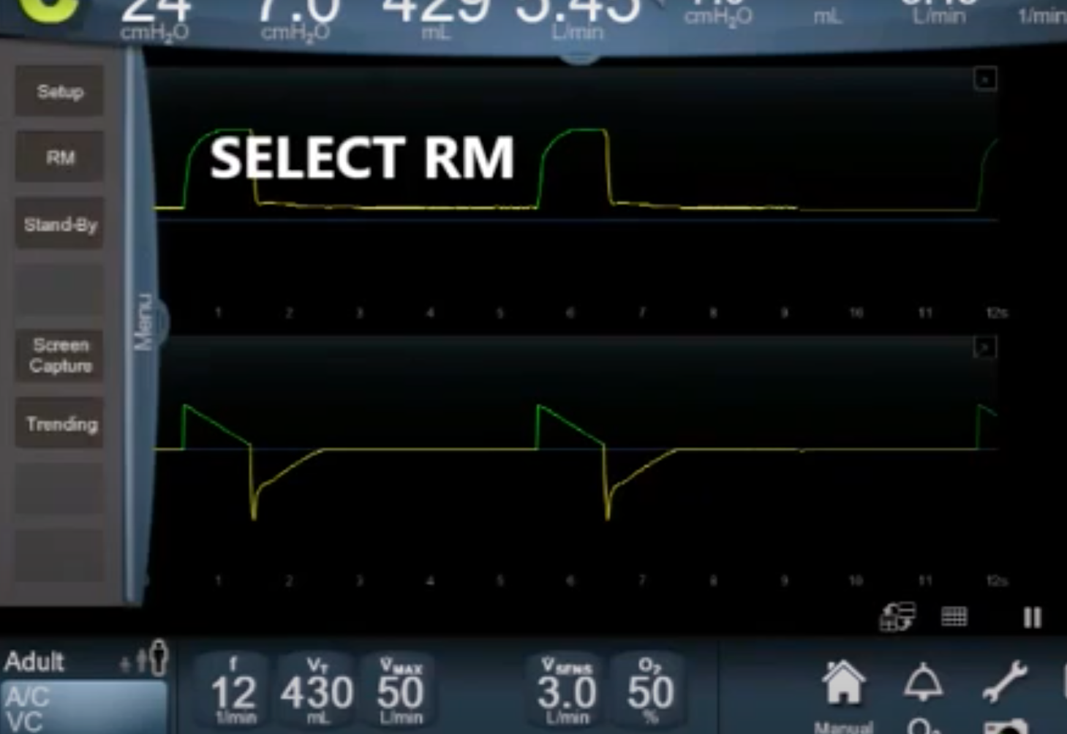
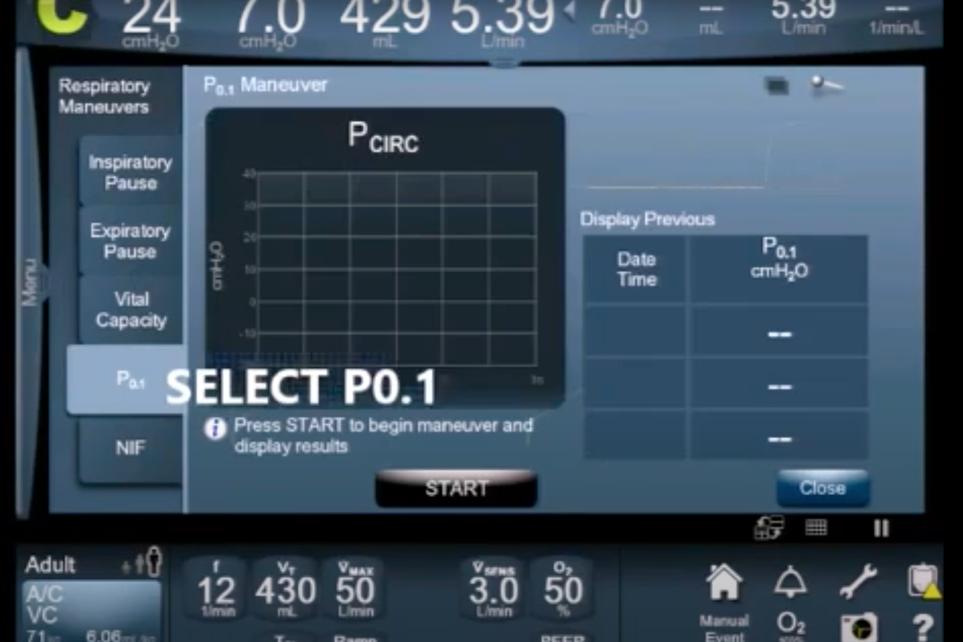

Slide 24
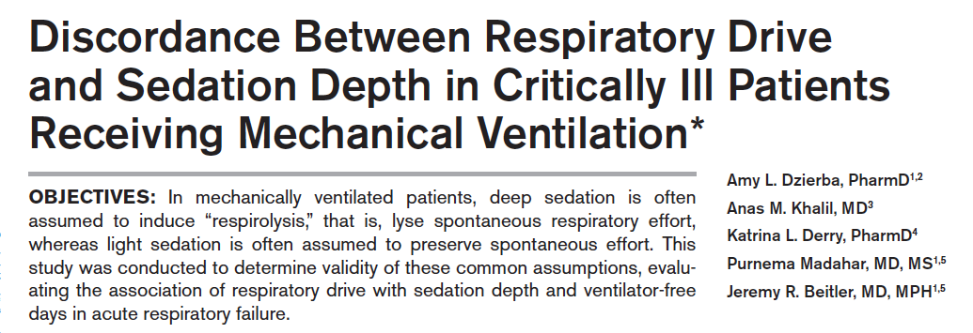
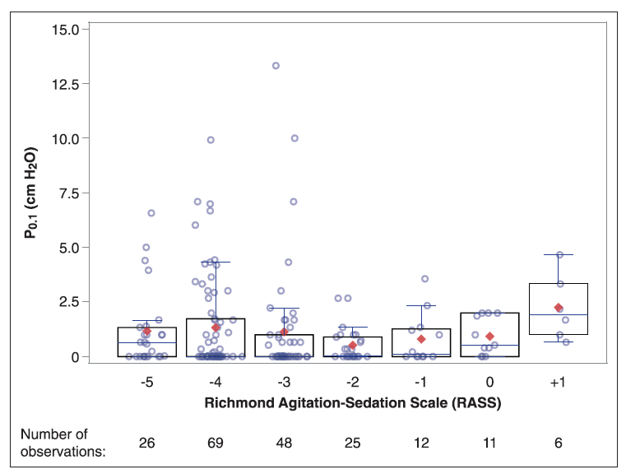
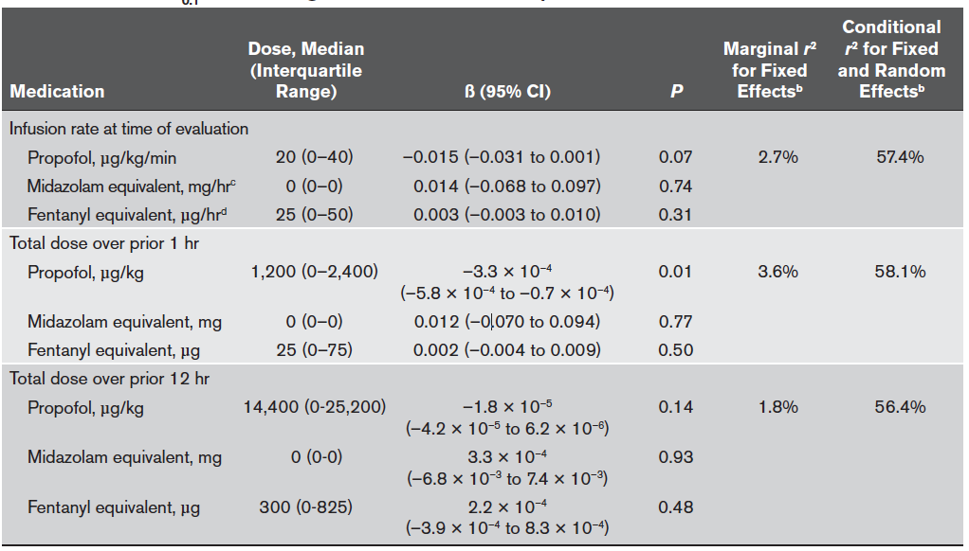
Notes:
56 mechanically ventilated patients; 197 observations. P0.1
(remember = muscle function and drive to breath)
RASS scale and CCPOT assessment of sedation
Linear mixed models were constructed
to evaluate the within-subject association of P0.1 with
sedation depth over time (fixed effects) with random
subject-specific intercept
P0.1
with pain, delirium, analgesic and sedative medication
exposure, blood gas results, respiratory parameters,
and illness severity over time.
No relationship between depth of sedation – just because a patient is sedated does NOT mean they are adequately respirolysed.
Near normal 0.1 associated with shortest time on Vent

Slide 25
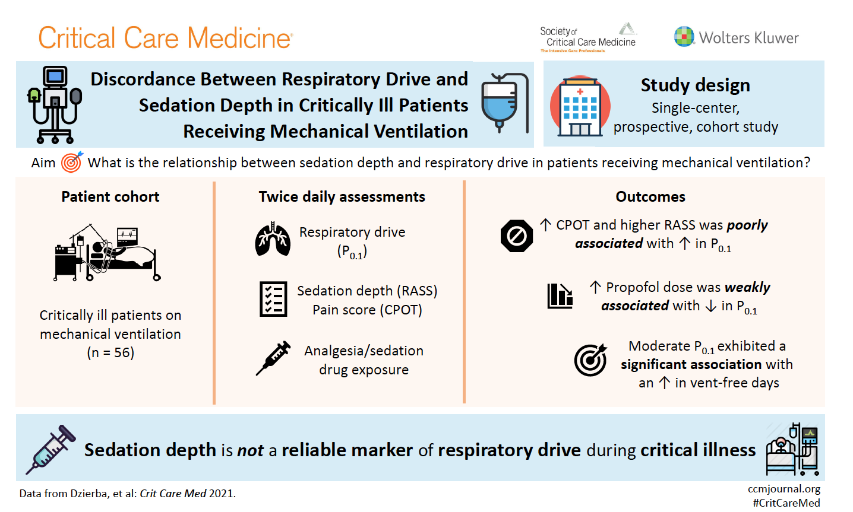
Notes:
Couple barriers to robust inferences from this
Reverse causation? Higher drive to breath -> more sedation
N=1 trial, or larger dataset with a multi-level regression model could perhaps sort this out
“ Specifically, a near normal P0.1 was associated with the highest number of VFDs, whereas values both below or above this were lower. Again, this was an observed association, not a causal relationship, ”

Slide 26
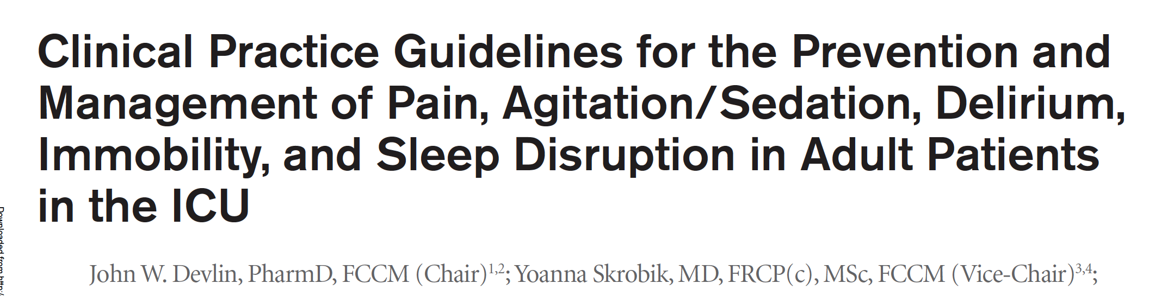
High Drive: What is our goal with sedation?
Blunting of the respiratory drive: opioids, sedatives, and NMBs (although NMBs aren’t actually blocking the drive, just the output)
Sedation: influences cortical inputs to drive to breath, AND may influence drive to breath directly

Slide 27
Opiate Induced Resp Depression
Mu receptor mediates pain relief and depression of respiration (normal RR drops first, then tidal volume reduced – HCVR and HVR reduced)
Partial agonists have a reduced effect on breathing
Equianalgesic doses of various opiates have same effect – though rapidity of onset determines whether apnea is caused, or just hypoventilation.
Degree of response is state dependent (co-ingestions, sex, physiologic state)
Notes:
“Laboratory studies in healthy
subjects show that opioids reduce the discomfort of air hunger
(166) but not the discomfort of work or effort (167). Opioids
likely act both by depressing spontaneous respiratory drive
(thus reducing corollary discharge), and by modulating cortical
activity, as they do in pain.
“
DOI: 10.1164/rccm.201111-2042ST
167. Supinski G, Dimarco A, Bark H, Chapman K, Clary S, Altose M. Effect
of codeine on the sensations elicited by loaded breathing. Am Rev
Respir Dis 1990;141:1516–1521.

Slide 28
Case resolution
ACVC+ → ACVC
Flow: 70
Vt 6 → 8 ml/kg IBW
Allowed for normal acceptable appearance, resolution of work shifting by waveforms, though still sedated too deeply to report dyspnea.

Slide 29
Takeaways
When lung protective ventilation and light sedation conflict, it often manifests as double triggering or work shifting.
We should avoid PRVC / ACVC+ whenever we are trying to use sedatives to reduce work of breathing – or else the mode is working against us, even if the vent pressures decrease.
Deep sedation does not assure a decreased drive to breathe; there are several options to assess this – P0.1 is easiest.
Topic for next time: relation of drive to breathe and patient comfort and Post-ICU syndrome
Notes:
Also, other states with high drive to breath: met acidosis, COVID?

Slide 30
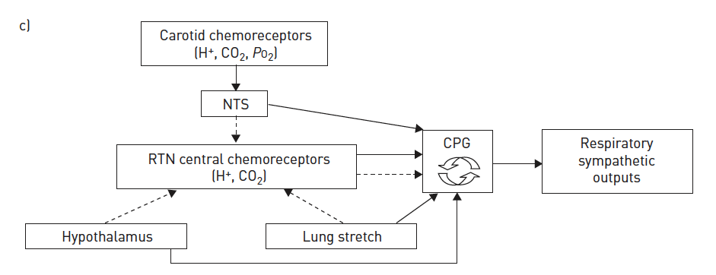
Notes:
Figure from
Pathophysiology of human ventilatory
control
Jerome A. Dempsey, Curtis A. Smith ERJ

Slide 31
Low drive -
“They keep going apneic when we try to put them on PS”
- if they are doing this, they are likely over-ventilated and are prone to disrupted sleep. Hypopneas won’t necessarily alarm the ventilator. [ ] look into ACVC data, or does it all come from PS? All PS. Don’t see this as much as I’d expect given altitude our threshold buffer is smaller.
-- not pathology, happens in everyone with vigorous enough PS
-- sleep-onset central apnea occurs in a large minority of people https://www.e-jsm.org/journal/view.php?number=91
Sedation
Metabolic alkalosis*** respiratory alkalosis?
Brainstem injury – how frequently does this happen from stroke? [ ] look in to this
Notes:
Patients ventilated
with pressure support commonly develop
central apneas during sleep, which does not
occur during assist-control ventilation
because of the backup rate (16).
17
16 Parthasarathy S, Tobin MJ. Effect of ventilator mode on sleep quality in
critically ill patients. Am J Respir Crit Care Med 2002;166:1423–1429.
17 Parthasarathy S, Tobin MJ. Sleep in the intensive care unit. Intensive
Care Med 2004;30:197–206.

Slide 32
Complete vs partial neuromuscular blockade?
Or intermittent

Slide 33
Revisiting dyspnea:
Sedation – and possibly opiates:
May be helpful for the affective component of dyspnea
?translate to reduced PICS / PTSD?
Probably not all that effective for relieving the inspiratory neural drive
Perhaps not changing respiratory mechanics as much as we think we are?
Are we underusing paralytic for this purpose?
(in a way, that’s what ROSE trial tested)

Slide 34
Ethical issue: when mechanics and symptoms conflict?
If LTVV is lung-protective, light sedation is protective – but light sedation with LTVV provokes air hunger, which is inhumane: do we have an ethical contradiction?
Do the ends justify the means?
Should we consent people to inflict air hunger beneficiently? Do the two need to go together?

Slide 35
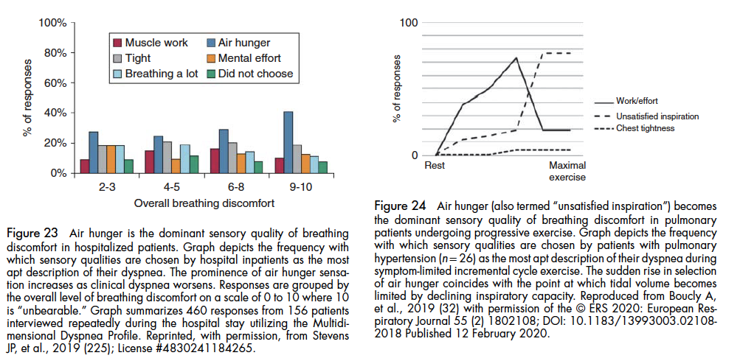
Air hunger vs work and effort
Air hunger arises when achieved ventilation does not match the demand for ventilation
Neuromuscular disease: respiratory muscles do not answer demand of respiratory control centers.
Patient with respiratory disorders (ventilatory limitation?( experience air hunger differently

Slide 36
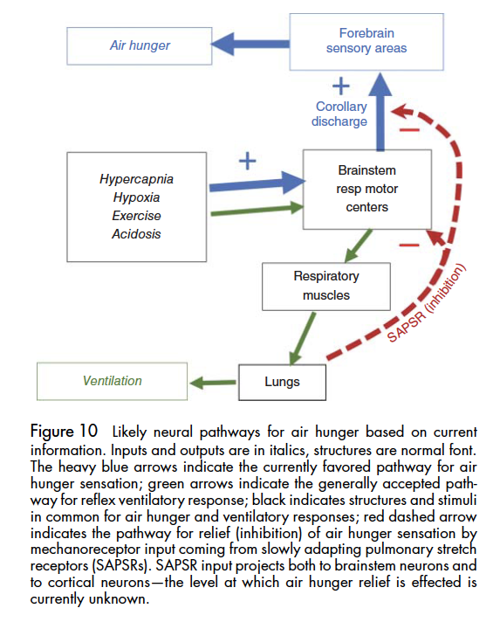
Why do we have air hunger?
E.g. blood flow is regulated outside of our consciousness to meet local demand; cardiac output is increased outside consciousness, etc.
Breathing is different- we have some voluntary control. Why?: diving animals; speech; food intake

Slide 37
Compr Physiol 11:1449-1483, 2021.
Air hunger = conscious appreciation of uncomfortable urge to breathe
Factors increasing air hunger: hypercapnia, hypoxia, exercise, acidosis.
Factors reducing air hunger: tidal expansion of lungs
Air hunger = minute ventilation < desired minute ventilation.
“The defining experimental paradigm to evoke air hunger is to elevate the drive to breathe while restricting the ability to increase ventilation”
Drive to breathe increased by modulating inhaled gas concentrations: Fio2 is week, FiCO2 is strong (esp if vent restricted). Acidosis works but uncontrollable; same with exercise.
Restriction of ventilation: external wraps, impedence via mouthpiece of mask, breath hold (limit has been shown to = interolable air hunger)
Free breathing = no restriction – have to use natural limits, which can only result in mild air hunger due to exp. Of lung
Copy of motor activity in medullariy respiratory centers projects on sensory cortex – then compared to signals of tidal lung inflation from pulmonary stretch receptors.
Notes:
Recent studies in which subjects
are quantitatively queried about dyspnea show that some
dyspnea is present during exertion in 22% of the nominally
healthy population and is significantly associated with risk of
mortality (208). Dyspnea at rest is reported by about 11% of
patients admitted to non-ICU medical/surgical units and is
associated with substantially higher risk of dying during that
hospitalization (223, 224).

Slide 38
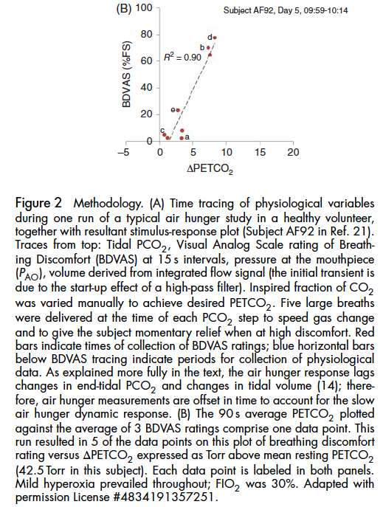
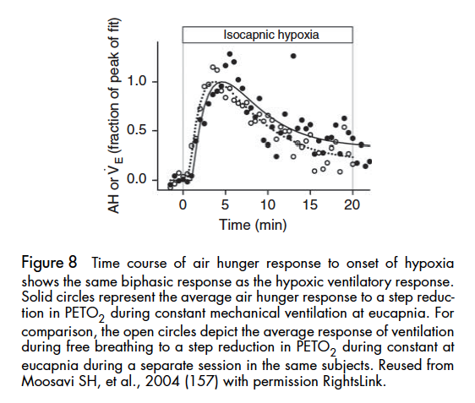
Air hunger vs changes in alveolar gasses
Conversely, few studies reported air hunger above 50% within the ethical standards of hypoxemia (confusion, somnolence occure before)
“Another study found that at PETO2 of 40 Torr during free breathing, subjects rated difficulty of breathing 20% of full scale, but this fell to 11% after 20 min of hypoxia(50).” – may not experience any air hunger if allowed to breathe freely.
“Hypoxia and hypercapnia appear to produce additive effects on air hunger, without changing the slope of the relationship (12, 148), but data on this interaction are sparse, so this observation should be further tested.”

Slide 39
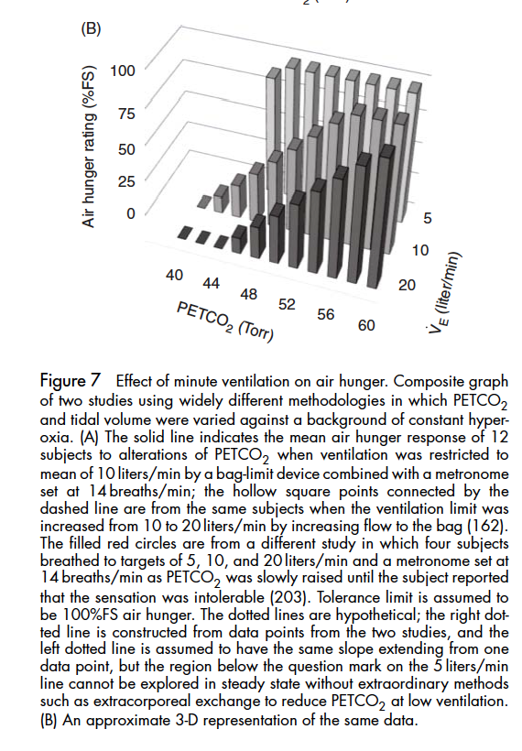
Inhibitory effect of breathing on air hunger
Can tolerate much higher CO2 if allowed to freely breath
Ventilated patients: tolerate a higher PaCO2 the higher the Vt is
“the tolerable level of PCO2 increased overall by about 0.74 Torr/liter/min ventilation“

Slide 40
Lung volume
Why can we hold our breath longer with a big breath hold? Clearly not the O2, as we noted before that hypoxia is week drive to breath
Additionally, data suggests subjects can hold their breath to lower O2 and higher PETCO2 with bigger breath

Slide 41
Note: the requirement that for brain death to have occurred, there has to be no breath efforts
Is built on the assumption that brainstem / chemoreflex is one of the most reliable indicators of some ”life” remaining.

Slide 42
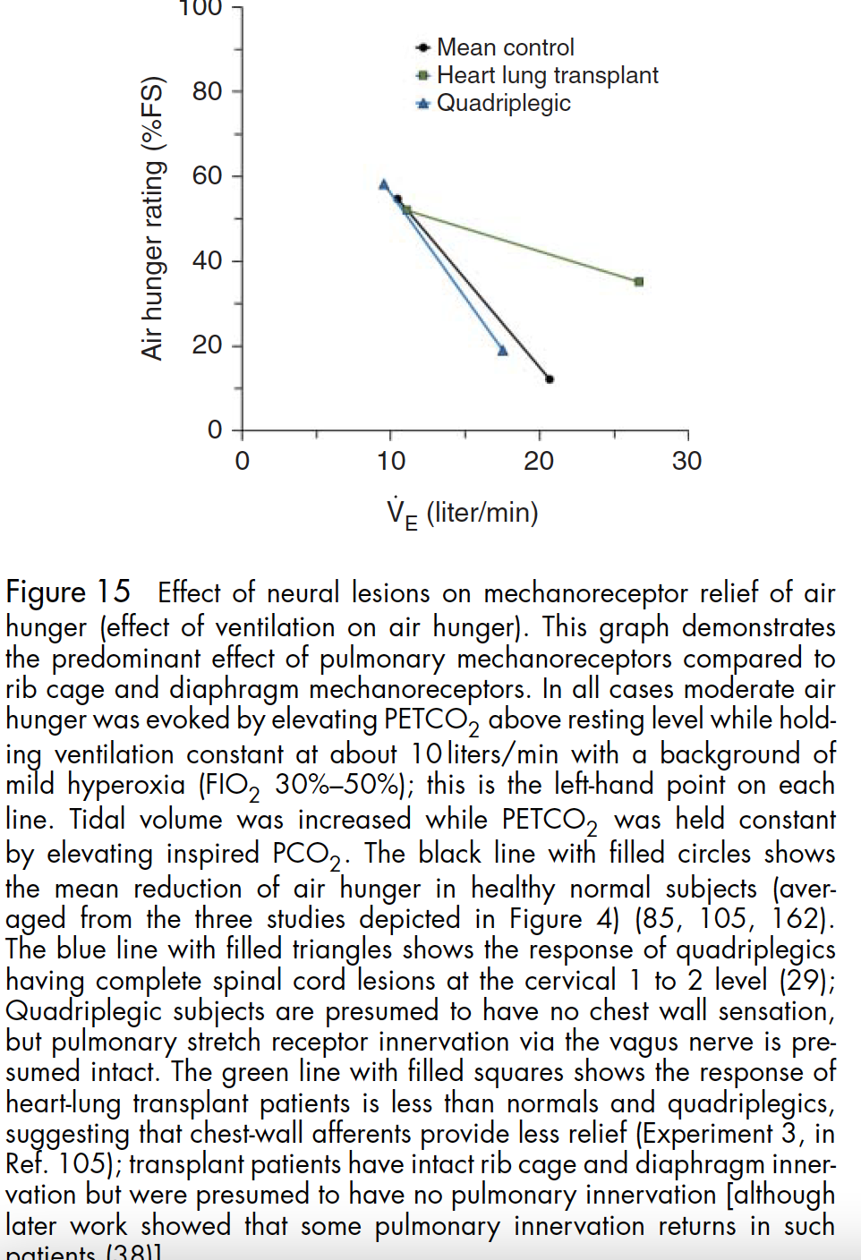
How does the body sense breath (to know whether the achieved ventilation is adequate)?
Not via gasses – as different tolerable PETCO2 is noted when CO2 is elevated by FiCO2 compared to reduced VA
Not via chest wall sensors – patients with C1-2 brainstem lesions (severed sensory nerves but intact vagus nerve) still can sense whether ventilation is adequate.
Via SASPRS from the VAGUS – reduced relief with breathing among patients who are transplanted (they do retain some innervation, e.g. of diaphragm, so not absent)
Interestingly, inhaled furosemide reduces the sensitivity of SASPRS
Notes:
This
study was repeated with two of the same patients and two
additional C1-C2 quadriplegics with the additional aim of
examining the locus of control (29). These experiments
showed that chest wall mechanoreceptors are not necessary
for relief, and in fact, the relationship between mechanore
ceptor
relief and ventilation seemed unaltered in quadriplegia
compared with healthy controls (Figure 15). Because these
quadriplegic subjects had no somatic innervation below the
neck (insofar as can be determined with clinical testing)
and the vagus nerve is spared in spinal cord injury, it is
presumed that vagal pulmonary afferents were responsible
for air hunger relief in this study. The most likely candidates
are SAPSRs.

Slide 43
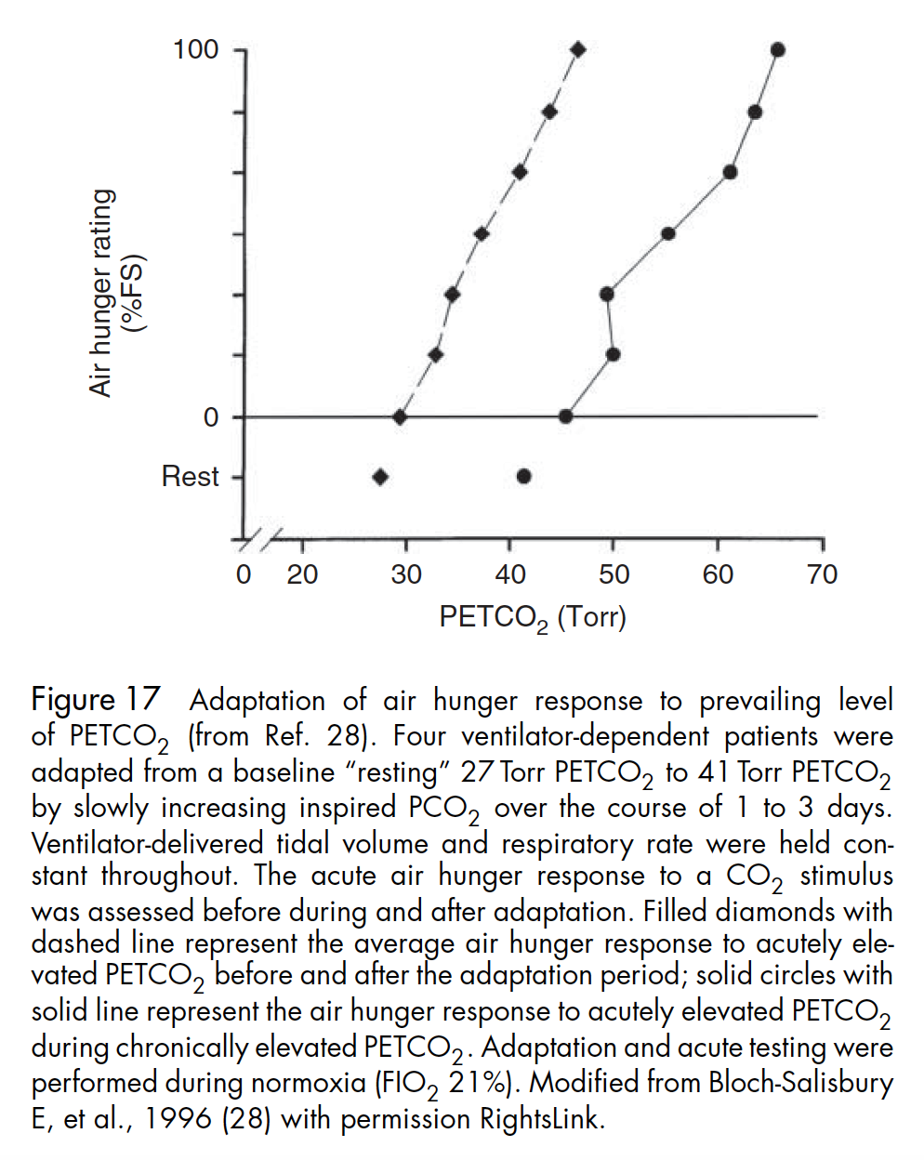
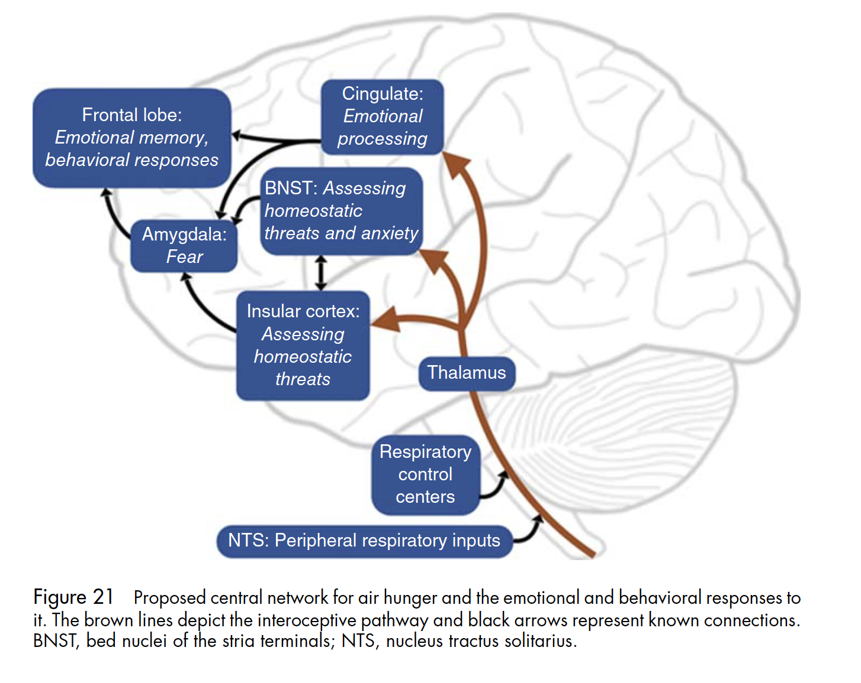
Cerebral Anatomy / Long term adaptation
Notes:
Does the acute response to air hunger persist during prolonged
hypercapnia, or does it adapt to the chronic condition? If it
does adapt, does the sensitivity decrease, does the threshold
(x-intercept) shift, or both?
Vent depedent neuromuscular disease patients given FiCO2 increased by 2% for 2-3 days – PETCO2 increased by 15 mmHg (no change to Va, set by ventilator)
After 2 to 3 days the acute air hunger response
adapted completely to the prevailing level of resting PETCO2
over the course of several days (28). There was no detectable
change in slope of the acute air hunger response to CO2, but
the x-intercept of the response shifted 15 Torr, that is, the
threshold for air hunger shifted equally to the shift in chronic
PETCO2, indicating complete adaptation.
When managing ventilator patients, attention should be paid
to the rate of increase in
PaCO2.
Although it may not be possi
ble
to gradually increase
PCO2
to allow adaptation, the period
(
of incomplete adaptation after a rapid rise in
PCO2
.2 days)
is likely to evoke air hunger, requiring close attention to phar
macological
and nonpharmacological symptom management
techniques

Slide 45
”The patient looks uncomfortable”
“Or, I had to go up on the sedation”
Observation (confounded) data suggests:
25% of all patients have dis-synchrony
50% who are the vent more than a day will.
They do worse. Maybe even worse mortality

Slide 46
https://doi.org/10.1164/rccm.202201-0078ED
Editorial for DyStress study (cited later)
“Nevertheless, dyspnea among critically ill patients has been shown to be the most distressing of ten symptoms studied (4) and has been found to afflict a significant percentage of patients during mechanical ventilation (5).“
“Dyspnea historically has been associated with increased work of breathing and the now decades old concept of length-tension inappropriateness (7)... The reality is that the origins of dyspnea are more complicated; the breathing discomfort may arise from stimulation of pulmonary and vascular receptors, chemoreceptors, and other factors that may be the source of the discomfort and/or enhance the drive to breathe”
“Furthermore, dyspnea is worsened when the output of the ventilatory system, e.g., tidal volume and inspiratory flow, is not consistent with the expected or desired output. This concept has been termed neuromechanical uncoupling or efferent-reafferent dissociation (8,9).
Notes:
critical care physicians have assiduously adhered to a low tidal volume strategy, sometimes necessitating permissive
hypercapnia and acute respiratory acidosis, to avoid ventilator induced lung injury (VILI) not
only for patients with the acute respiratory distress syndrome (ARDS) but for most patients with
acute respiratory failure necessitating mechanical ventilation. The restriction of tidal volume in
patients with acute lung disease and a strong drive to breathe is likely to cause an intense sense
of “air hunger” (12).
Of those individuals who survive
mechanical ventilation, a significant percentage will have emotional and behavioral problems,
including symptoms consistent with post-traumatic stress disorder (PTSD), in the months and
years after extubation (14), and a case has been made for dyspnea as a contributing factor for this
outcome (15).
With respect to dyspnea, clinicians frequently make inferences
from findings on physical exam that indicate “respiratory distress,” although these findings are
generally reflecting an increase in respiratory drive (e.g., use of accessory muscles of ventilation,
nasal flaring)
“
Citations:
[ ] review this one 4. Puntillo KA, Shoshana A, Cohen NH, at al. Symptoms experienced by intensive care unit
patients at high risk of dying. Crit Care Med. 2010;38;2155-2160.
5. Schmidt M, Demoule A, Polito A. et al. Dyspnea in mechanically ventilated critically ill
patients. Crit Care Med. 2011;39:2059- 2065.
7. Campbell EJM, Howell JBL. The sensation of breathlessness. Br Med Bull. 1963;19:36-40.
[ ] 8. O’Donnell DE, Ora J, Webb KA, et al. Mechanisms of activity-related dyspnea in pulmonary
diseases. Respir Physiol Neurobiol. 2009;167 :116-132.
9. Schwartzstein RM, Manning HL, Weiss JW, et al. Dyspnea: A sensory experience. Lung.
1990;168:185-199.
[ ] 12. Banzett RB, Lansing RW, Binks AP. Air Hunger: A primal sensation and a primary element
of dyspnea. Compr Physiol. 2021;12:1449-1483.
[ ] 14. Schelling G, Stoll C, Haller M, et al. Health-related quality of life and posttraumatic stress
disorder in survivors of the acute respiratory distress syndrome. Crit Care Med. 1998;4:651-659.
[ ] 15. Worsham CM, Banzett RB, Schwartzstein RM. Dyspnea, Acute Respiratory Failure,
Psychological Trauma, and Post ICU Mental Health: A caution and a call for research. Chest.
2021;159:749-756.

Slide 47
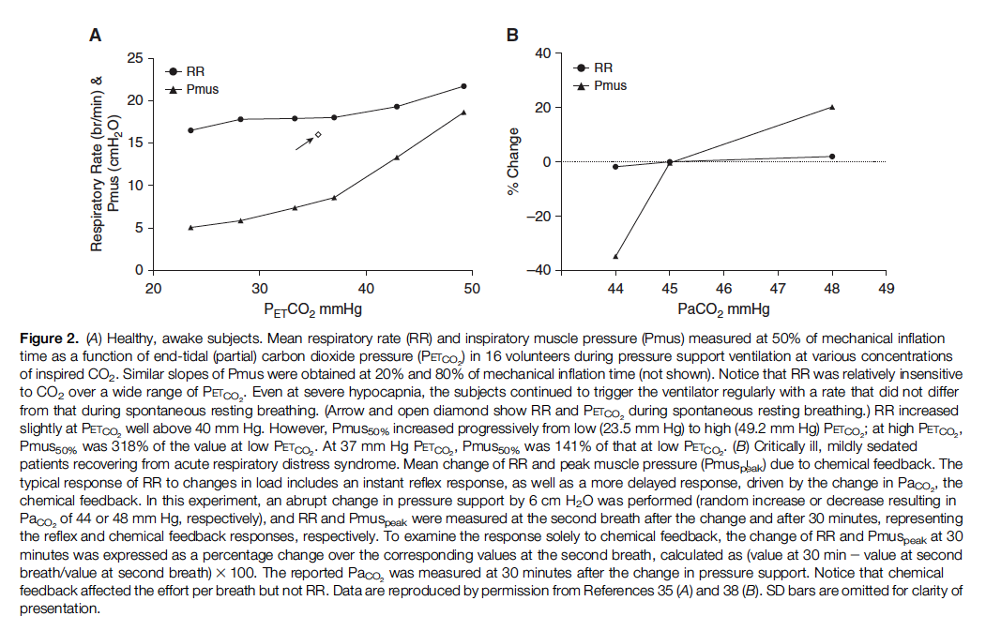
Clinical exam? [ ] summarize comments
RR insensitive (no change until 3-4 fold increase) *** Nunns?
Dyspnea if they can tell you
Accessory muscule use, diaphoresis, tachycardia (gets used by nurses)
All exam signs are blunted in neuromuscular disease or injury.
Notes:
Figure: A) Healthy, awake subjects. Mean respiratory rate (RR) and inspiratory muscle pressure (Pmus) measured at 50% of mechanical inflation
time as a function of end-tidal (partial) carbon dioxide pressure (PETCO2) in 16 volunteers during pressure support ventilation at various concentrations
of inspired CO2. Similar slopes of Pmus were obtained at 20% and 80% of mechanical inflation time (not shown). Notice that RR was relatively insensitive
to CO2 over a wide range of PETCO2. Even at severe hypocapnia, the subjects continued to trigger the ventilator regularly with a rate that did not differ
from that during spontaneous resting breathing. (Arrow and open diamond show RR and PETCO2 during spontaneous resting breathing.) RR increased
slightly at PETCO2 well above 40 mm Hg. However, Pmus50% increased progressively from low (23.5 mm Hg) to high (49.2 mm Hg) PETCO2; at high PETCO2,
Pmus50% was 318% of the value at low PETCO2. At 37 mm Hg PETCO2, Pmus50% was 141% of that at low PETCO2. (B) Critically ill, mildly sedated
patients recovering from acute respiratory distress syndrome. Mean change of RR and peak muscle pressure (Pmuspeak) due to chemical feedback. The
typical response of RR to changes in load includes an instant reflex response, as well as a more delayed response, driven by the change in PaCO2, the
chemical feedback. In this experiment, an abrupt change in pressure support by 6 cm H2O was performed (random increase or decrease resulting in
PaCO2 of 44 or 48 mm Hg, respectively), and RR and Pmuspeak were measured at the second breath after the change and after 30 minutes, representing
the reflex and chemical feedback responses, respectively. To examine the response solely to chemical feedback, the change of RR and Pmuspeak at 30
minutes was expressed as a percentage change over the corresponding values at the second breath, calculated as (value at 30 min2value at second
breath/value at second breath)3100. The reported PaCO2 was measured at 30 minutes after the change in pressure support. Notice that chemical
feedback affected the effort per breath but not RR. Data are reproduced by permission from References 35 (A) and 38 (B). SD bars are omitted for clarity of
presentation.
[ ] summarize these for the slide
In fact, breathing
frequency response is minimal over a PaCO2
range from 23 to 45 mm Hg (35–37, 39).
Especially on ACVC?
Isolated changes in PaCO2 exert their
influence mainly through modification of
inspiratory effort per breath and much less
through modification of respiratory rate.
Studies of breathing patterns in
response to either external load or
unloading with increasing levels of assist
revealed that a patient’s respiratory rate
either does not change or changes modestly
(usually up to 20%). This contrasts with
the severalfold changes in a patient’s
effort per breath (30, 31, 40, 41, 44, 45).
One may reasonably argue
that in awake patients, an abrupt increase in
respiratory load (induced by modification
of ventilator settings or respiratory system
mechanics alteration) quite often evokes
high respiratory rates. This is largely
attributed to cortical influence (behavioral
feedback) due to a discrepancy between
respiratory center output and ventilator
output.
2. Akoumianaki E, Vaporidi K, Georgopoulos D. The injurious effects of
elevated or nonelevated respiratory rate during mechanical ventilation.
Am J Respir Crit Care Med 2019;199:149–157.

Slide 48
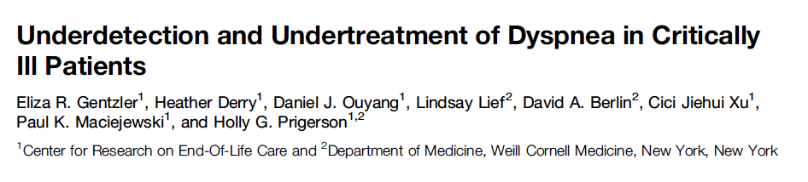
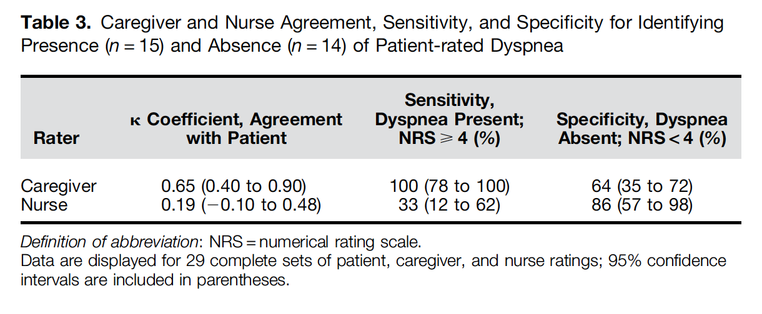
Dyspnea Assessment – [ ] split into different talk?
Caregiver performance
Nurse performance
Reference standard: patient report (MICU patients who could communicate)
Notes:
DOI: 10.1164/rccm.201805-0996OC
50. Gentzler ER, Derry H, Ouyang DJ, Lief L, Berlin DA, Xu CJ, Maciejewski PK, Prigerson HG. Underdetection and Undertreatment of Dyspnea in Critically Ill Patients. Am J Respir Crit Care Med 2019;199:1377–1384.

Slide 49
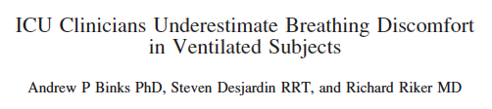
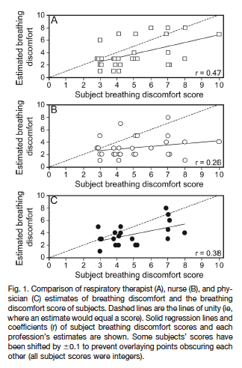
30 intubated patients able to communicate at 1 center
Patients: dyspnea, 0-10 on a visual scale
Within 15 minutes: RT, RN, and MD estimated discomfort. Reported cues:
RTs: ventilator flow patterns &facial expression
RNs: heart rate, resp rate
MDs: facial expression, nasal flaring, restlessness, accessory muscles.
Notes:
Twenty-one subjects were assessed by all
3 of each subject’s clinicians (MD, RT, and RN); only the
RN and RT of the remaining 9 subjects gave estimates
(no MD was immediately available).
3). The RTs tended to look for
evidence of asynchrony in the ventilator flow patterns and
backed this up with subject assessment (use of accessory
muscles, restlessness, nasal flaring, and facial expression).
The MDs typically started with subject assessment, particularly
with facial expression but also nasal flaring, restlessness,
and use of accessory muscles. RNs typically
looked at heart rate and breathing frequency with the more
experienced being able to recognize that the subject was
“fighting” the ventilator from observation of the subject.
49. Binks AP, Desjardin S, Riker R. ICU Clinicians Underestimate Breathing Discomfort in
Ventilated Subjects. Respir Care 2017;62:150–155.

Slide 50


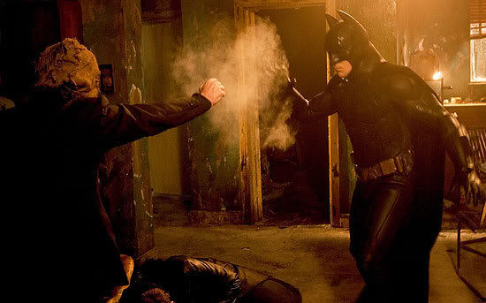
Batman Begins (2005)
Administrator Crane aka Scarecrow
Villain trick: sprays gas that makes people lose their mind in fear

Slide 51
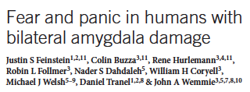

Urbach-Wiethe Disease: bilateral amygdala damage due to fat deposits.
Patient S.M.: No conditioning to aversive stimuli, no fear in life-threatening situations, no recognition of fear in others
35% Inhaled CO2 challenge
Provoked panic attack
First sensation of fear sense childhood
Reproduced in others with U-W Disease
Notes:
Fear from brain-vent curve dissociation is NOT mediated by the medulla; it’s more primitive
Case report so interesting it’s published in Nature.
FiCO2 35% and the case of S.M.
SM, amygdala fat deposits, carbon dioxide inhaled fear. Due to Urbach-Wiethe Dz
No fear to conventional stimuli, but high concentration of inhaled CO2 (35%) still provoked panic - ‘first time experienced fear since childhood’ https://www.nature.com/articles/nature.2013.12350
https://www.nature.com/articles/nn.3323
==> fear mechanism is independent of amygdala. (In this case fear comes through the chemo receptors, and not to the amygdala)
Justin Feinstein NIH grant Oklahoma inhaled carbon dioxide
https://grantome.com/grant/NIH/P20-GM121312-01-6548
RCT - https://clinicaltrials.gov/ct2/show/NCT03925987

Slide 52
Air Hunger: panic independent of amygdala
Widely understood that the distress of breathlessness is different:
Waterboarding / asphyxiation as torture
55 survivors of torture: asphyxiation strongest predictor of PTSD
No ceiling effect (risk of PTSD) to repeat episodes – nearly unique
279 survivors of torture in Eastern block: most unpredictable (uncontrollability leads to hopelessness), second most aversive (only after rape)
Notes:
Evolutionarily, this makes sense. - incredibly aversive stimulus.
In fact – they had worse panic -> possibly the amygdala normally inhibits panic (or modulates it somehow.
Başoğlu M
. Waterboarding is severe torture: Research findings. Mass Trauma, Mental Health & Human Rights. https://metinbasoglu.wordpress.com/2012/12/25/waterboarding-is-severe-torture-research-findings/ Date last updated: December 25, 2012. Date last accessed: August 27, 2016.
Google Scholar
↵Başoğlu M,
Livanou M,
Crnobarić C
. Torture vs other cruel, inhuman, and degrading treatment: Is the distinction real or apparent? Arch Gen Psychiatry 2007; 64: 277–285.
CrossRefPubMedGoogle Scholar
↵Başoğlu M,
Mineka S
. The role of uncontrollable and unpredictable stress in post-traumatic stress responses in torture survivors. In: Başoğlu M, ed. Torture and its Consequences: Current Treatment Approaches. Cambridge, Cambridge University Press, 1992; pp. 182–225.

Slide 53
DyStress – REVA Network prospective cohort https://www.atsjournals.org/doi/abs/10.1164/rccm.202108-1857OC
2016-2018; N=612. Patients requiring 24+ hrs of IMV, enrolled once able to communicate. Assessed daily
762 assessed but not enrolled – mostly couldn’t communicate.
Exposure: “Are you having trouble breathing now”, 0-10 VAS to quantify
Choose between: air hunger, excessive respiratory effort. Also, anxiety+pain
Outcomes: 34% dyspnea @ enrollment (71% air hunger), severity 5
ICU LOS: 6d vs 6d for dyspneic and non-dyspneic
90d interview: PTSD – 29% vs 13%; rate highest in patients choosing “Air Hunger”
Independently associated in multivariable model (OR 2.47) account for other chars
Limitation: unknown if the rate of dyspnea (or recollection) is ↑ or ↓ in patients unable to communicate.
Notes:
“In their study of over 600 patients with acute respiratory failure,34% reported dyspnea prior to initiation of spontaneous breathing trials. Although mortality and
ICU length of stay were not different between the two groups, nearly 30% of patients reporting
dyspnea subsequently were determined to have probable PTSD compared to 13% in those
without dyspnea.”
---> takes a few days for metabolic compensation to occur
And editorial - https://www.atsjournals.org/doi/full/10.1164/rccm.202201-0078ED
In some sense, we know this – that’s why people who find torture ethically permissible decided waterboarding is a good way to do it.
Mostly on Pressure Support at the time of assessment.
Other notable things: much LESS likely to be dyspneic if intubated with acute on chronic respiratory failure. Neuroplasticity?

Slide 54
Dyspnea in sedated?
sedation may give an external appearance of respiratory comfort, but
falsely reassuring (32, 46)
32. Decavèle M, Similowski T, Demoule A. Detection and management of dyspnea in mechanically ventilated patients. Curr Opin Crit Care 2019;25:86–94.
Notes:
However, inappropriate ventilator settings remain a leading cause of dyspnea in ICU patients: optimizing ventilator settings could reduce its intensity in 35% of patients exhibiting dyspnea [6]. The ACV mode is independently associated with dyspnea, especially when the inspiratory flow is <60 L/min. Conversely, proportional assisted ventilation [54] and neutrally adjusted ventilator assist [55] are associated with less dyspnea.
Opioids are the mainstay of pharmacological management of dyspnea with a clearly demonstrated effectiveness [61].
6
Schmidt M, Demoule A, Polito A, Porchet R, Aboab J, Siami S, Morelot-Panzini C, Similowski T, Sharshar T. Dyspnea in mechanically ventilated critically ill patients. Crit Care Med. 2011; 39:2059–2065.
First large prospective study of dyspnea in intubated patients. One third of cases, dyspnea can be alleviated with simple ventilator settings optimization.

Slide 55
Dyspnea (specifically, air hunger) is uniquely aversive, hard to identify, and probably associated with PICS / Post-ICU PTSD

Slide 56
Diaphragm stimulation and review
https://www.atsjournals.org/doi/abs/10.1164/rccm.202202-0315ED

Slide 57
https://www.frontiersin.org/articles/10.3389/fmed.2022.874250/full#B25
Ways to increase tolerance of NIV
Notes:
Schmidt M, Banzett RB, Raux M, Morélot-Panzini C, Dangers L, Similowski T, et al. Unrecognized suffering in the ICU: addressing dyspnea in mechanically ventilated patients. Intensive Care Med. (2014) 40:1–10. doi: 10.1007/s00134-013-3117-3
Banzett RB, Pedersen SH, Schwartzstein RM, Lansing RW. The affective dimension of laboratory dyspnea: air hunger is more unpleasant than work/effort. Am J Respir Crit Care Med. (2008) 177:1384–90. doi: 10.1164/rccm.200711-1675OC
Cao Z, Luo Z, Hou A, Nie Q, Xie B, An X, et al. Volume-targeted versus pressure-limited noninvasive ventilation in subjects with acute hypercapnic respiratory failure: a multicenter randomized controlled trial. Respir Care. (2016) 61:1440–50. doi: 10.4187/respcare.04619

